Slide 1
CO_Lab 1 ALU
TA: Yi, Lee
E-mail: nctubio@gmail.com

Slide 2


Installation of Icarus Varilog and GTKWave
Make sure that you install these softwares with administrator
Open cmd.exe and move to directory the .v file you are working on
Execute commands mentioned in the pdf file, then you will get corresponding files

Slide 3
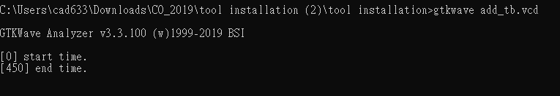
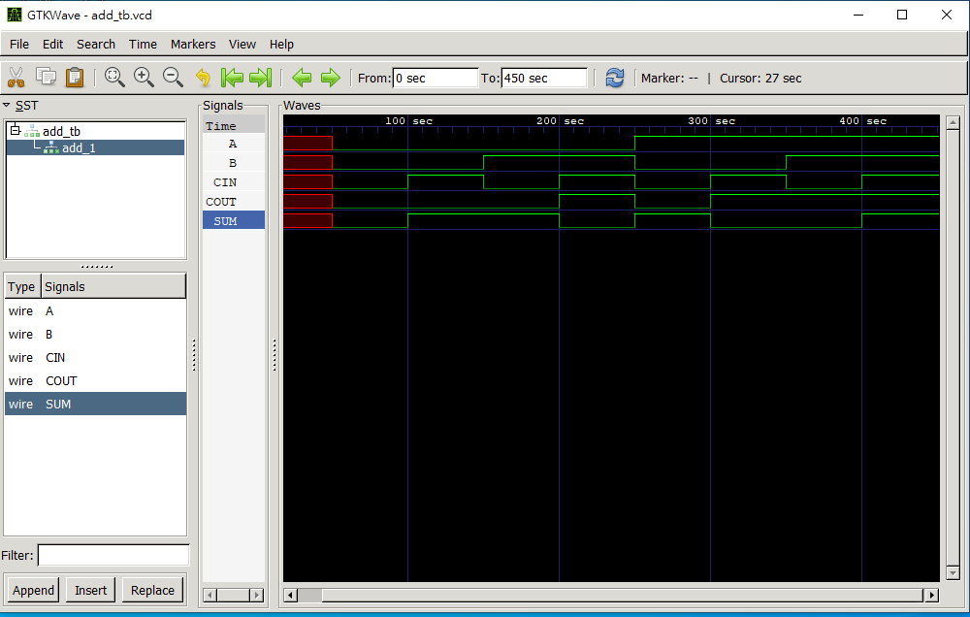
Execute gtkwave to see the results
Double clicks these signals
Look out for the time scale

Slide 4
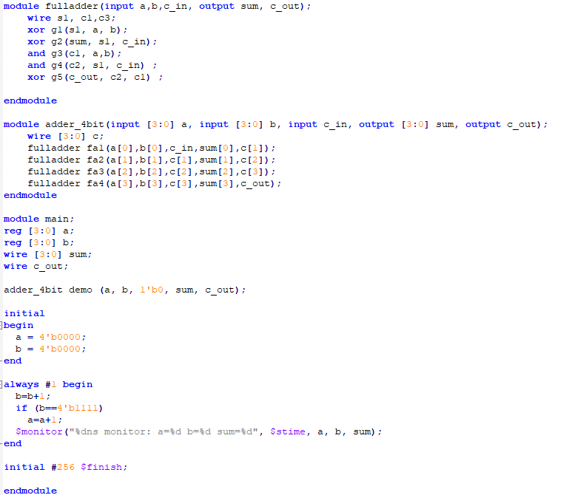
Hint
Complete this lab with 32 one-bit ALU is more recommended than one 32-bits ALU, which means that you will not get full scores if you do the latter one.
Thus, knowing the concept of module would be helpful. It is also good for you to improve your coding style.
Example of module fulladder called by another module.
Module main is like a test bench to demonstrate the result.

